Slide 1
Managing Environments with Helm and Kustomize

Slide 2
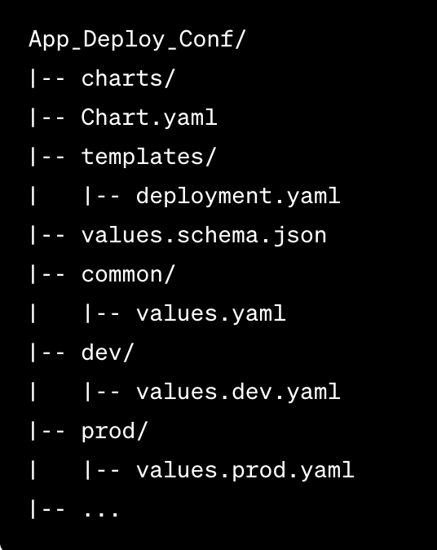
Helm Example
Project Structure

Slide 3
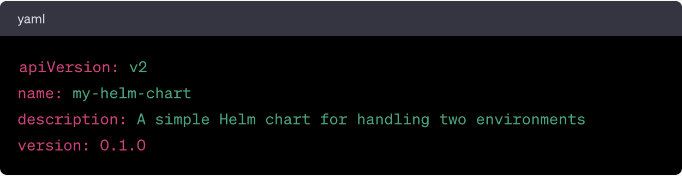
Helm Example
Chart.yaml

Slide 4
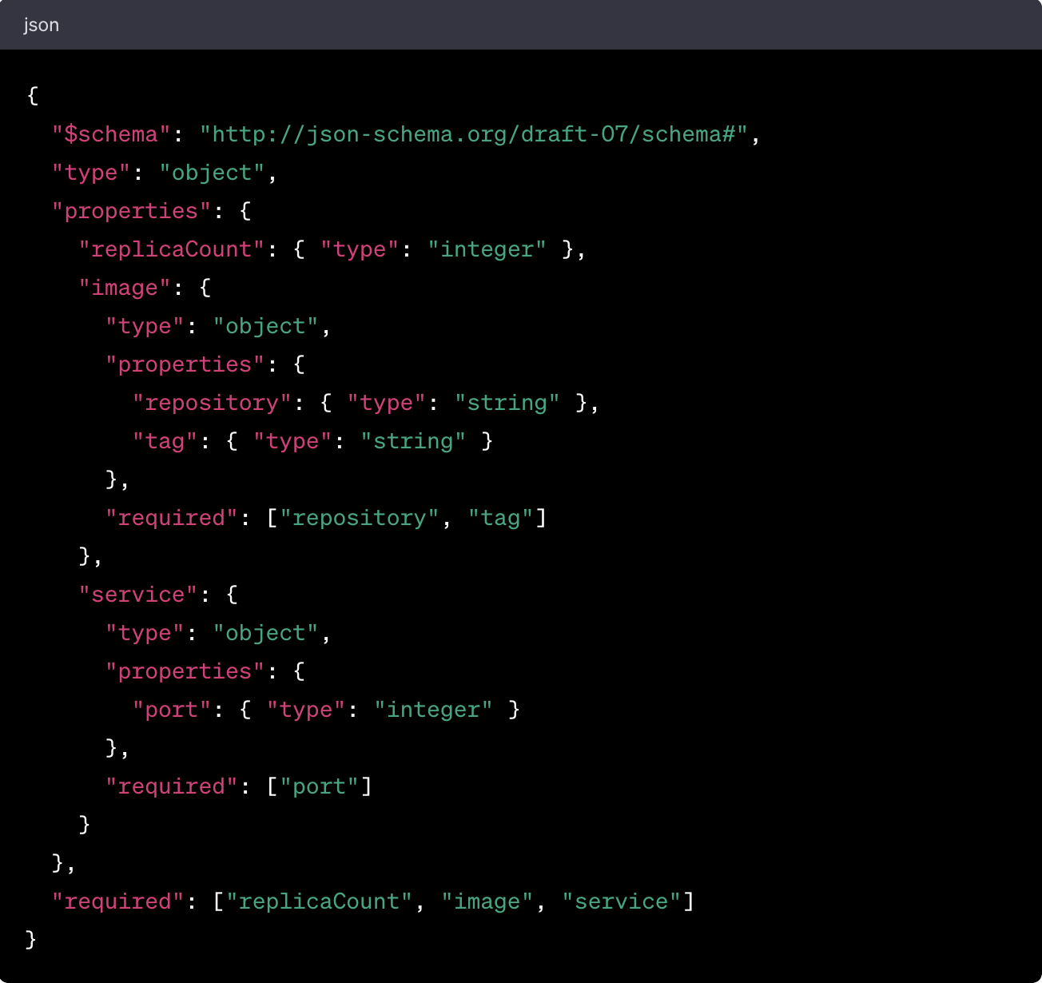
Helm Example
values. schema.json

Slide 5
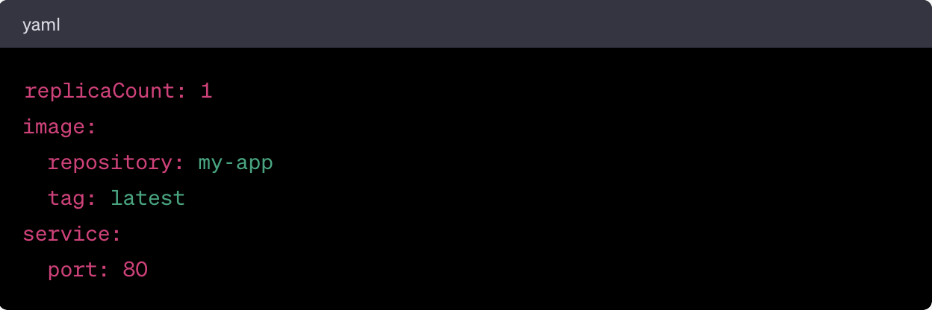
Helm Example
Values.yaml

Slide 6
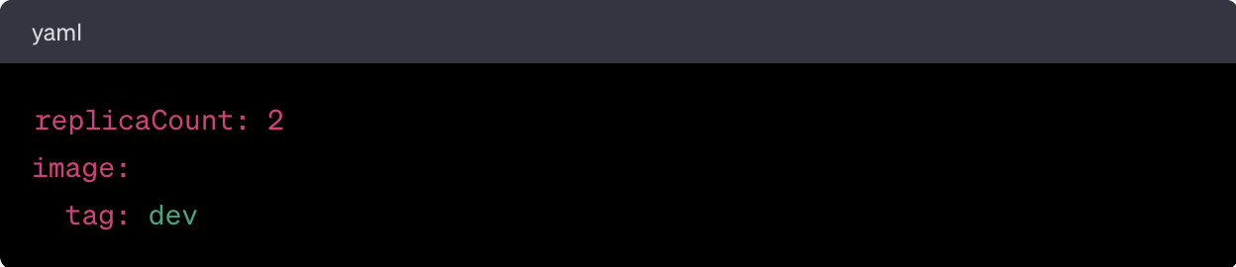
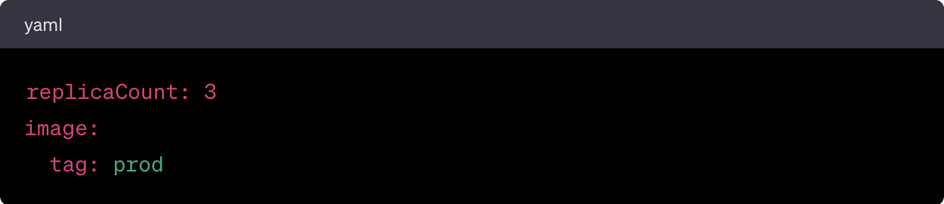
Helm Example
values.dev.yaml
values.prod.yaml

Slide 7
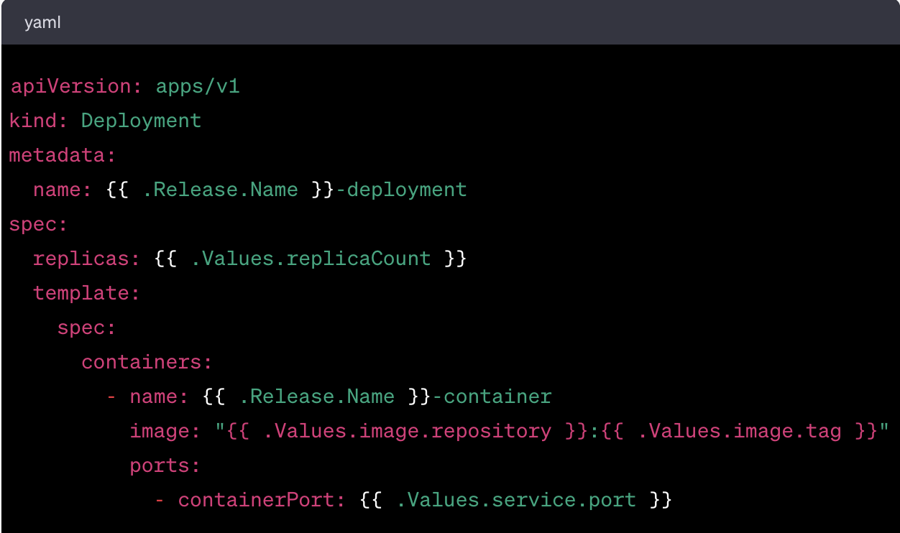
Helm Example
deployment.yaml

Slide 8
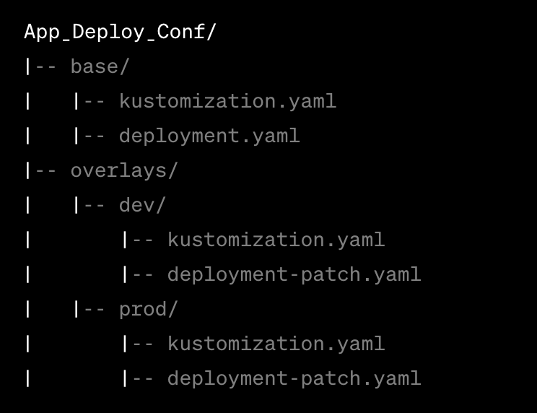
Kustomize Example
Project Structure

Slide 9
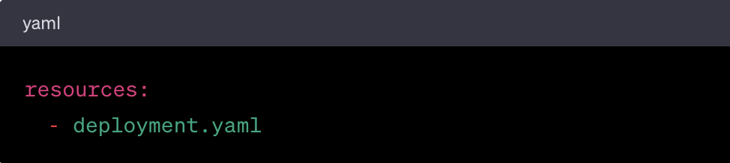
Kustomize Example
base/kustomization.yaml

Slide 10
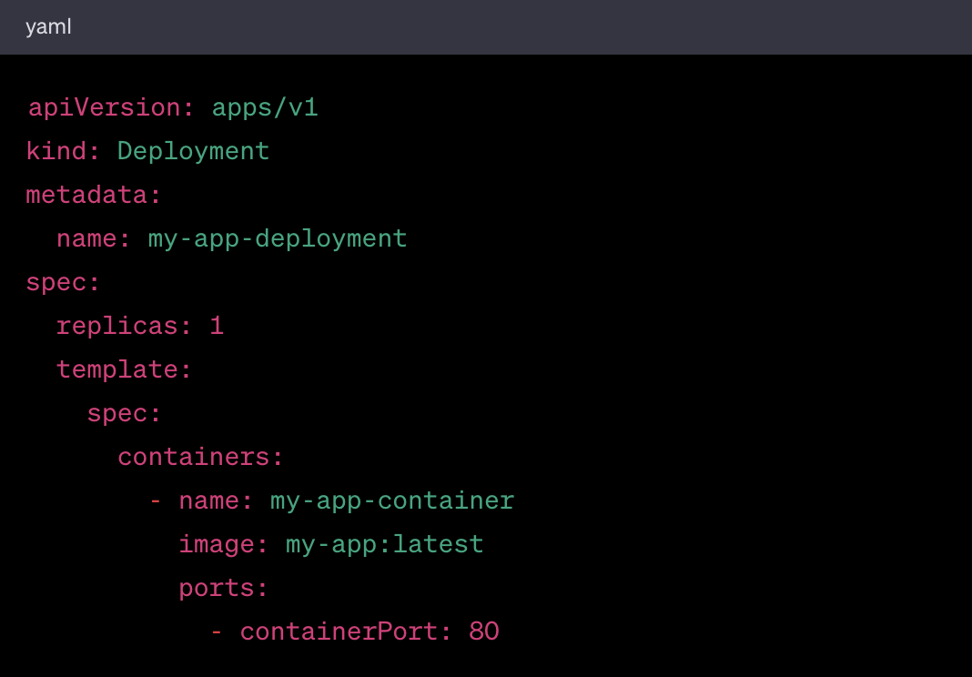
Kustomize Example
base/deployment.yaml

Slide 11
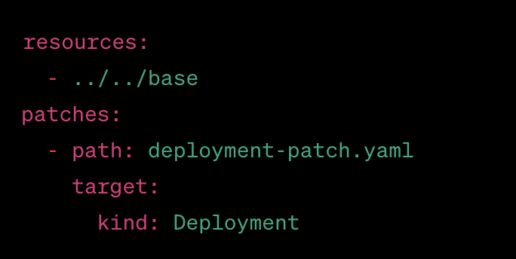
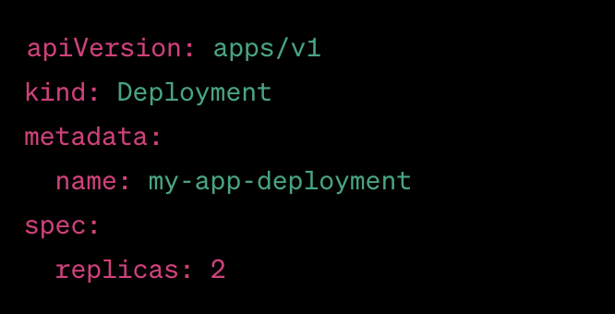
Kustomize Example
overlays/dev/kustomization.yaml
overlays/dev/deployment-patch.yaml

Slide 12
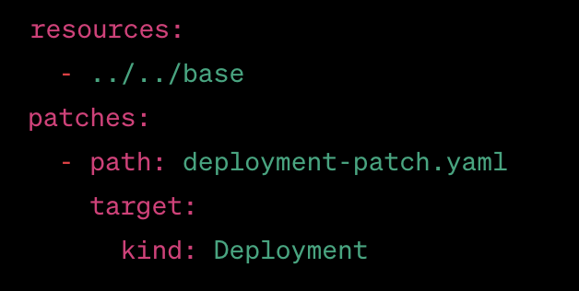
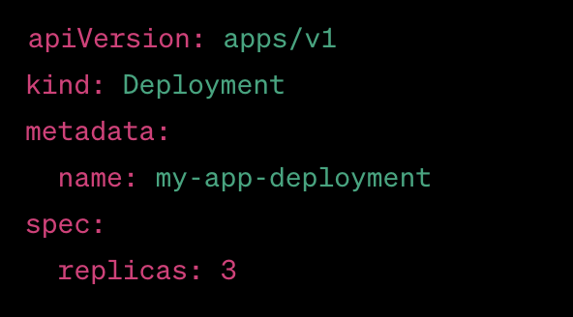
Kustomize Example
overlays/prod/kustomization.yaml
overlays/prod/deployment-patch.yaml

Slide 13
Managing application properties: Kustomize vs helm

Slide 14
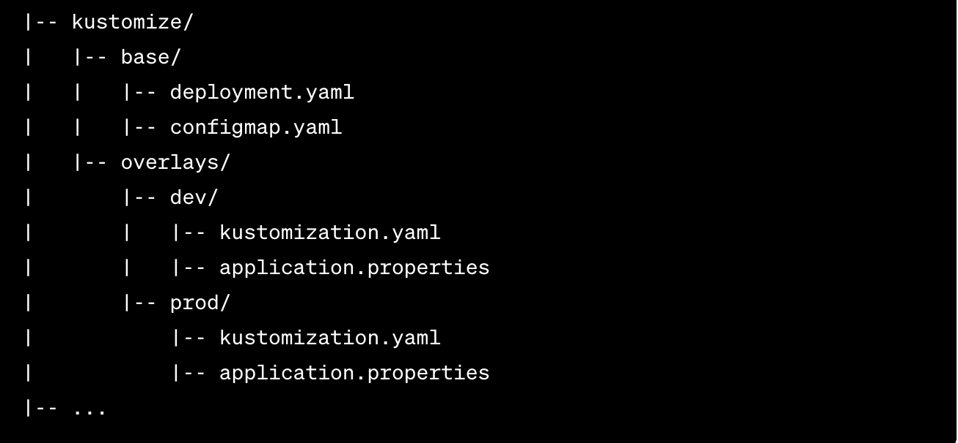
Managing application properties: Kustomize
Project Structure

Slide 15
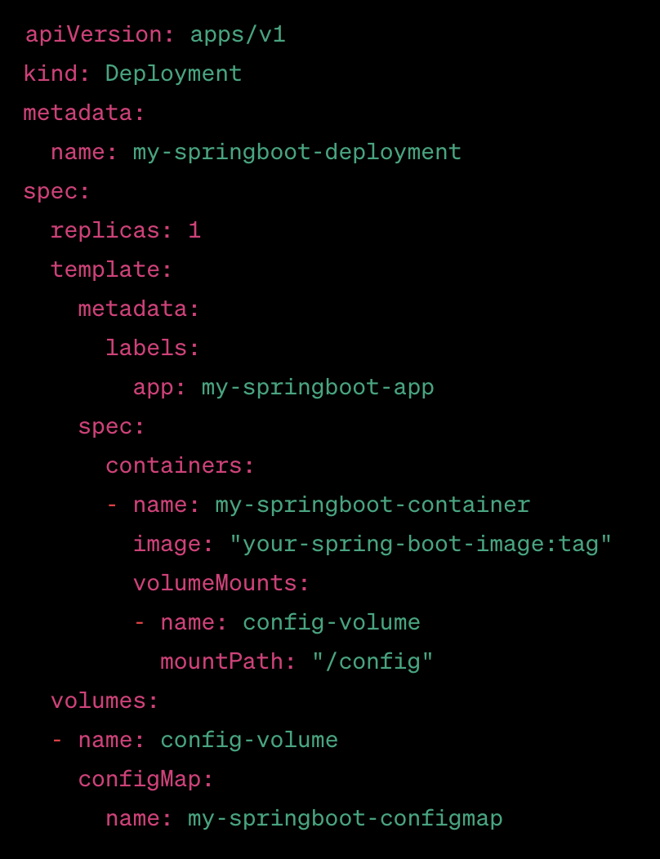
Managing application properties: Kustomize
kustomize/base/deployment.yaml

Slide 16
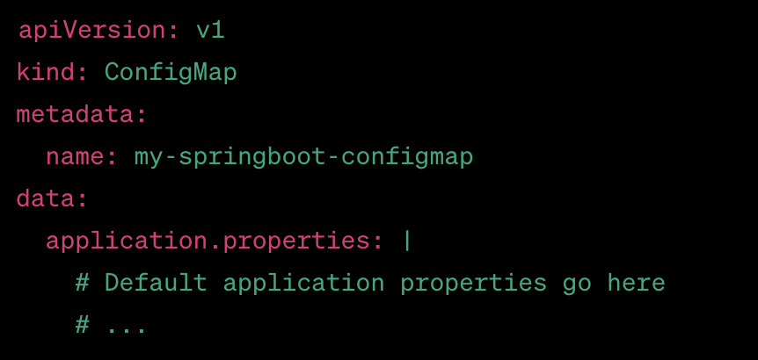
Managing application properties: Kustomize
kustomize/base/configmap.yaml

Slide 17
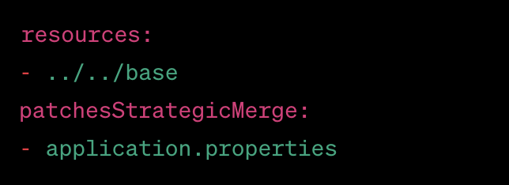
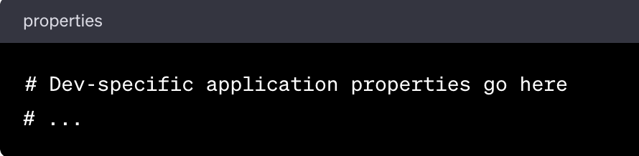
Managing application properties: Kustomize
kustomize/overlays/dev/kustomization.yaml
kustomize/overlays/dev/application.properties

Slide 18
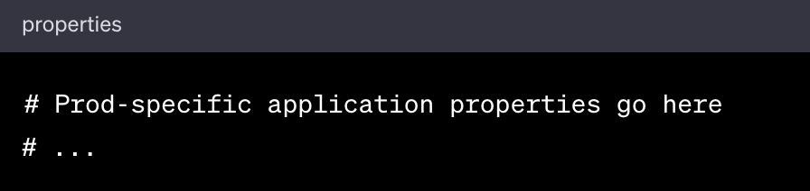
Managing application properties: Kustomize
kustomize/overlays/prod/kustomization.yaml
kustomize/overlays/prod/application.properties

Slide 19
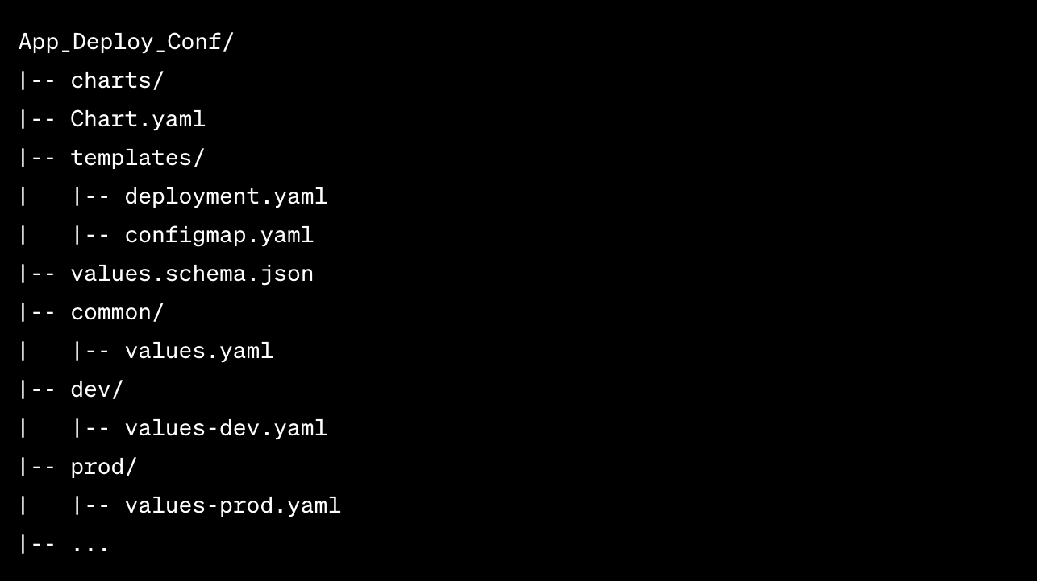
Managing application properties: Helm3
Project Structure

Slide 20
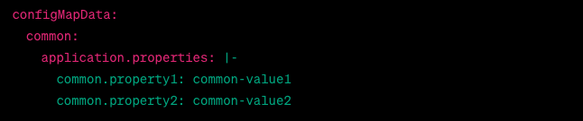
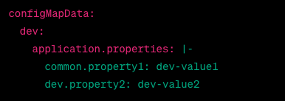
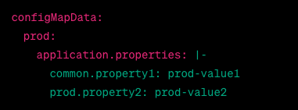
Managing application properties: Helm 3
values.yaml
values-dev.yaml
Values-prod.yaml

Slide 21
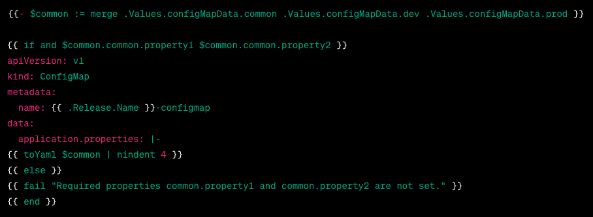
Managing application properties: Helm 3
templates/configmap.yaml

Slide 22
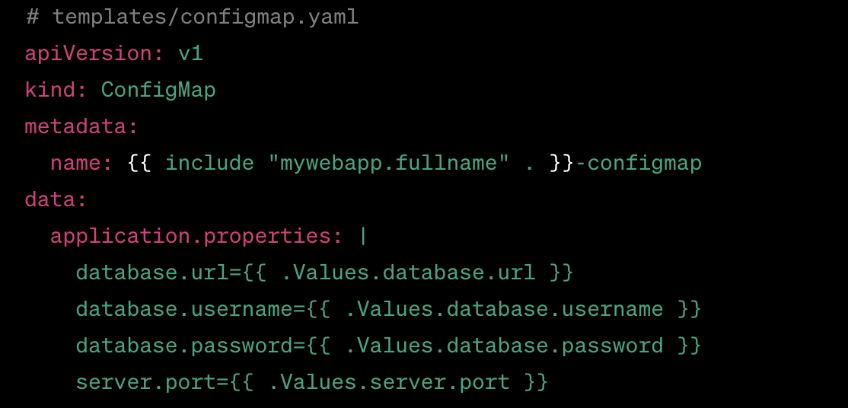
Managing application properties: Helm 3 – example 2
templates/configmap.yaml

Slide 23
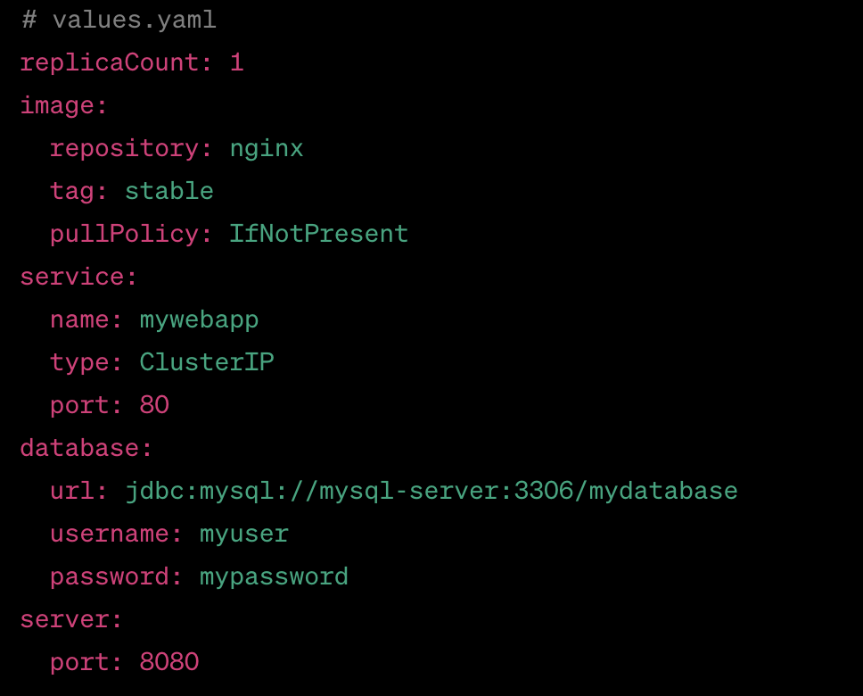
Managing application properties: Helm 3 – example 2
values.yaml

